Slide 1
Online Event Scheduler
Under the guidance of:
Mentor: Prof. Jinjun Xiong TA: Amir Nassereldine By:
Lakshaye Vaikunth Ganesh Kumar
Arjun Ragavendaar Sripathy
Sri Harshitha Palla
Divya Sharma
Venkatesh Mandapati

Slide 2
Backend Development
Creation of Skeleton Structure
Create API to initiate poll
Create API to get poll details
Create API to store details of poll participants
Create API to get participant details for an event
GCP VM setup of Backend code

Slide 3
Upcoming Backend Development Tasks
Connecting to the Database over GCP
Modify retrieved database information to required response format
Create API POST method for account-wise calendar details
Create API GET method for account-wise calendar details
Create API to create and store 1:1 or 1:many meetings
Handle recurring events in calendar API

Slide 4
Frontend Development
Implemented home screen UI
Implemented Meeting Poll UI
Implemented 1-1 Meeting UI
Implemented Dashboard UI

Slide 5
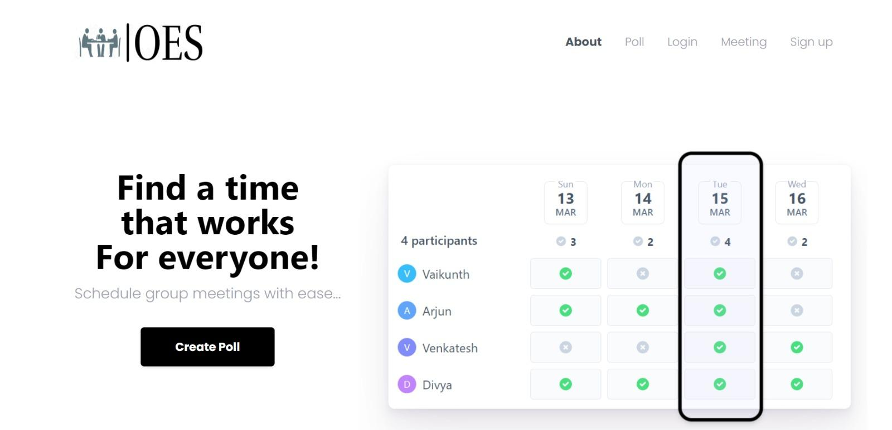
Screens:

Slide 6
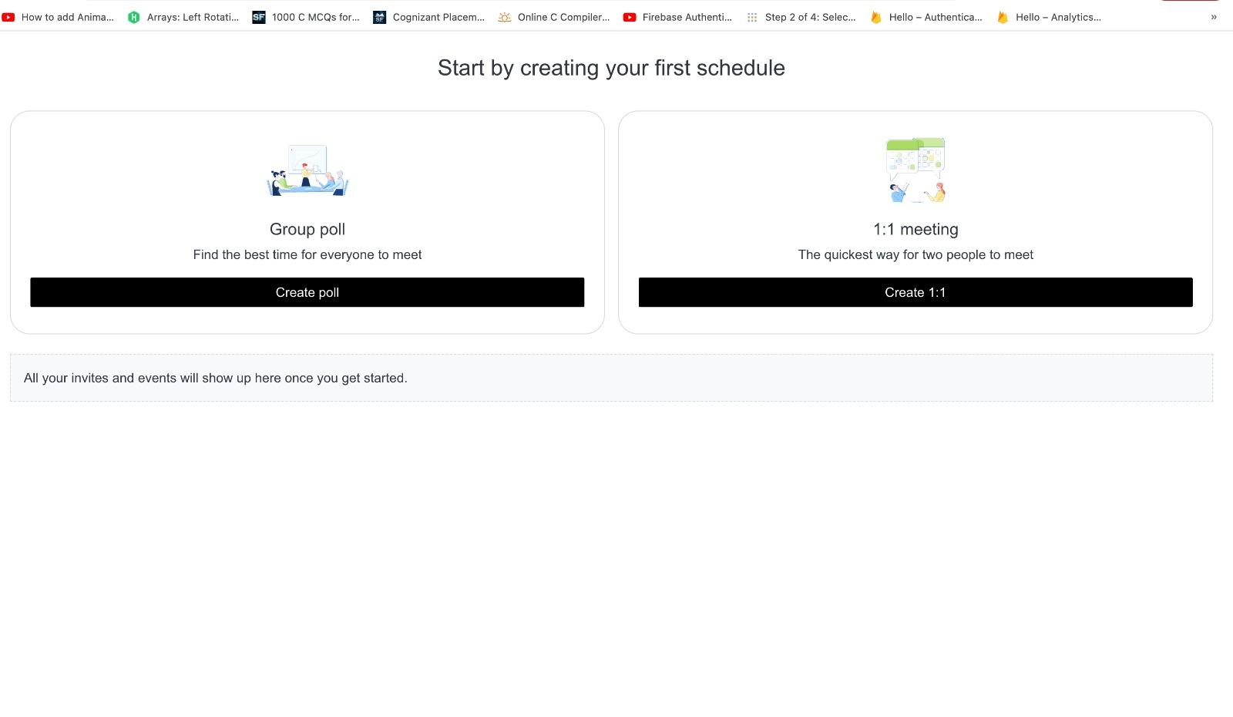

Slide 7
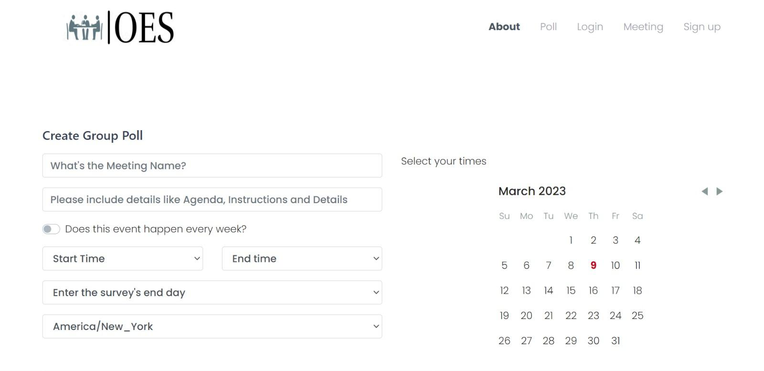
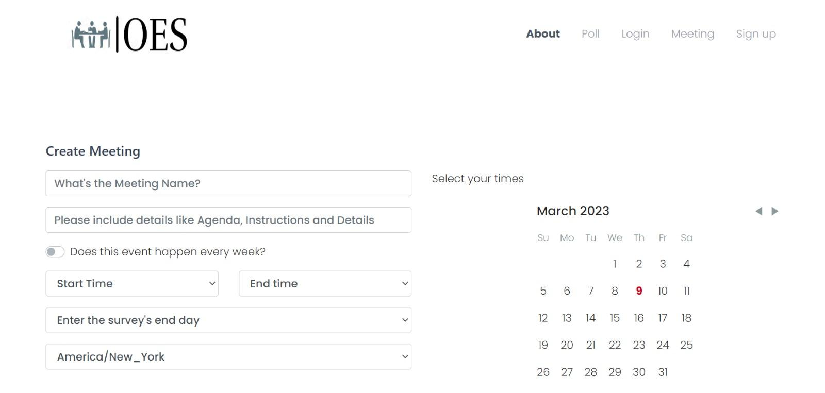
Screens:

Slide 8
Upcoming Frontend Development Tasks
Create Calendar view to select slots
Create Recurring and intersection of slots view
Implement Procedure for submitting selected slots to POST API
Implement Procedure for invoking GET API to get participants slot selection data.

Slide 9
Database
MySQL setup on local machine
Modifying the database schema
Create schemas for the DB
Populating synthetic data to the DB
GCP setup of the DB
Creation of tables on GCP

Slide 10
Upcoming Database Tasks
Modifying schema wrt Backend and Frontend
Implement Procedure for invoking GET API to get participants slot selection data
Establish DB connection to the application
SQL queries for data retrieval
Updating ER Diagram

Slide 11
References
https://console.cloud.google.com/welcome?project=avid-willow-380021

Slide 12
THANK YOU

